Slide 1
Activity Planning
Constantinos Constantinou
Freya Craig
Edward Gillespie

Slide 2
What is an “Activity”?
A condition in which things are happening or being done.
A schedule phase in a project with beginning and end.
Usually is made by several tasks.

Slide 3
Why Project Management it is important?
Leadership
Clear Focus & Objectives
Realistic Project Planning
Quality Control
Orderly Process

Slide 4
Project Schedule Planning Example
Step 1: Define Activities
Step 2: Sequence them
Step 3: Estimations of time and resources

Slide 5
A Case Study
Susan and Steve have decided to get married. They want a June wedding, but it’s already January. Just thinking about all of the details involved is overwhelming. When they were choosing the paper for the invitations, the couple realized that they needed help. They called a Wedding Planner.
The to do list for the wedding:
Invitations
Flowers
Wedding Cake
Dinner Menu
Band
Needs to be done before June ( 6 months)

Slide 6
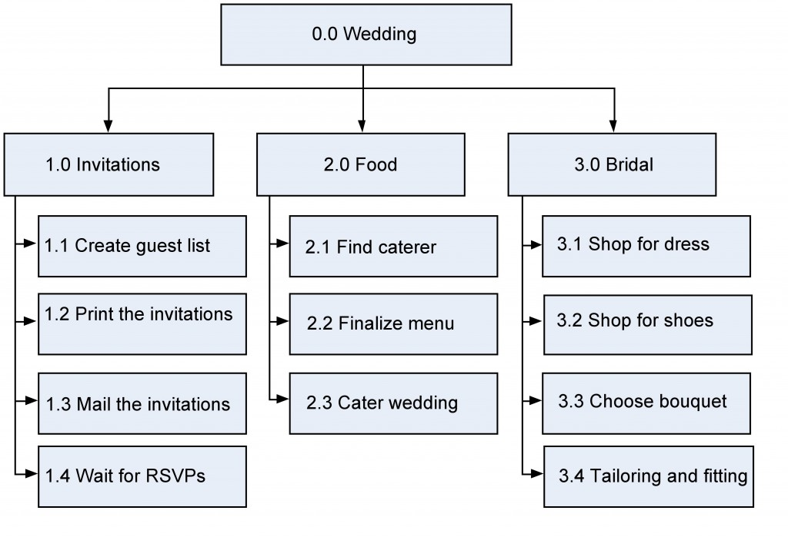
Work Breakdown Structure (WBS) based on project phase

Slide 7

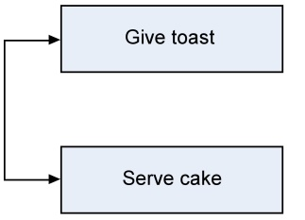
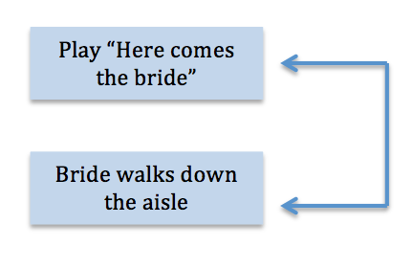
Main kinds of Predecessor Activities
Finish-to-Start (FS)
Start-to-Start(SS)
Finish-to-Finish(FF)

Slide 8
Milestones
Some milestones for the wedding might be:
Invitations sent
Menu finalized
Location booked
Bridesmaids’ dresses fitted

Slide 9
Somethings that could go wrong:
“The band cancelled. They had another wedding that day”
“Should we really have a pan flute player? I’m beginning to think it might be overkill”.
“Maybe we should hold off on printing the invitations until these things are work out.”
When that happens we need to create a change request and send it through the change control system.

Slide 10
Activity Sequencing
The activity sequence process is used to determine what activity attribute comes first, second, third, etc.
Here is the point to make couple of changes to the scope if neseccary

Slide 11
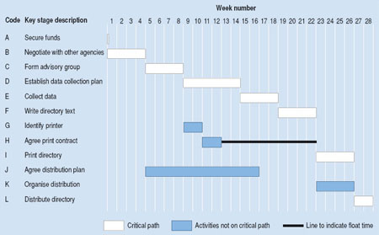
Creating the Gantt Chart

Slide 12
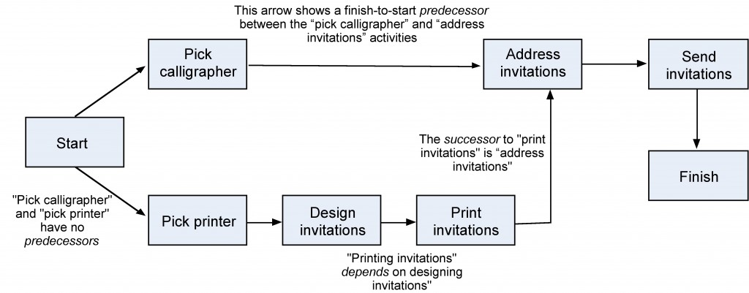
Creating the Network Diagram

Slide 13
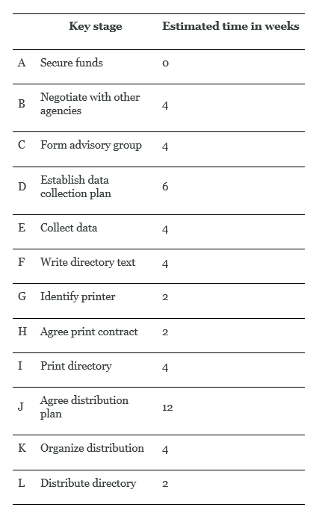
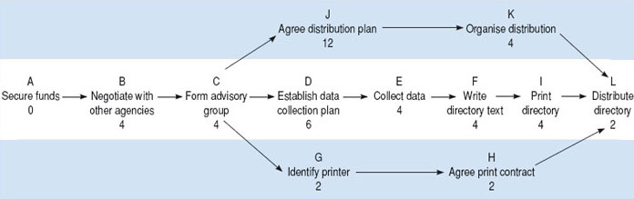
The Critical Path

